Slide 1
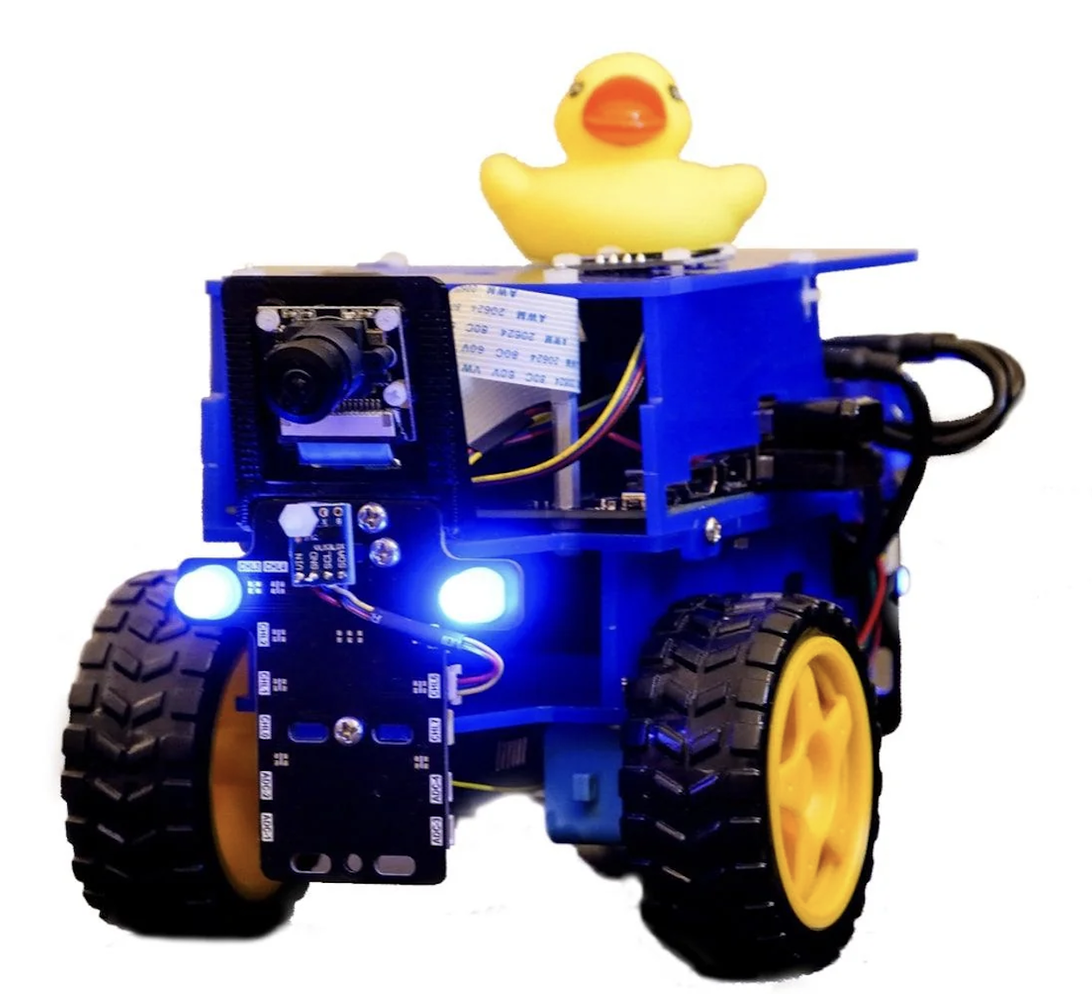
Dynamic Obstacle Avoidance
RIS Project Zain Samdan
Jose Guzman
Jaime Garcia

Slide 2
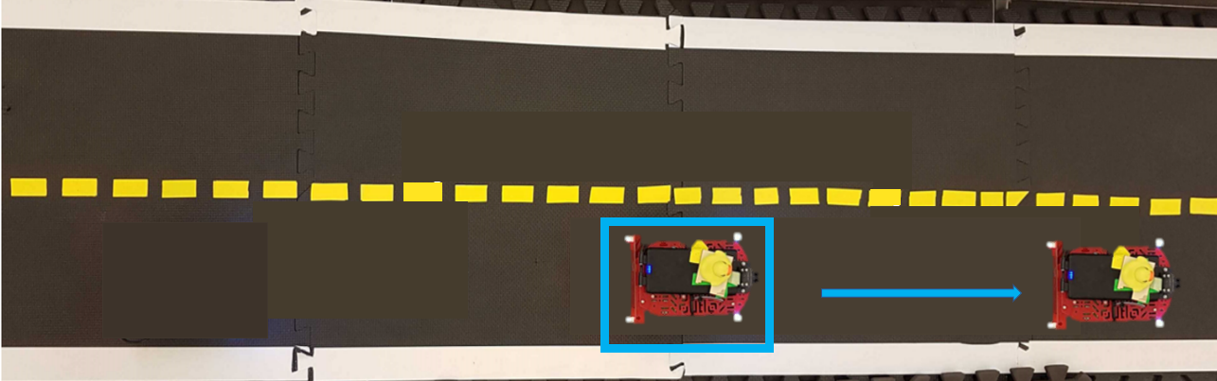
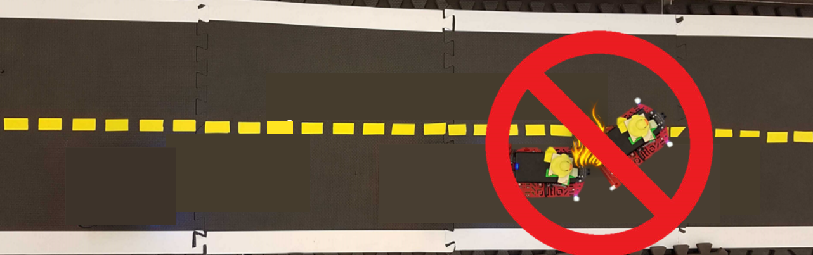
Dynamic Obstacle avoidance
Enabling Duckiebots to detect and navigate around dynamic obstacles like other Duckiebots without clashing, ensuring the safety of the duckietown
Notes:
Duckiebots face the challenge of safely maneuvering through environments with dynamic obstacles, This project aims to develop a feature for Duckiebots to detect and navigate around dynamic obstacles, enhancing their operational capabilities. By implementing an obstacle detection and avoidance system, Duckiebots can autonomously navigate around other Duckiebots, ensuring safe interactions with obstacles thereby improving their real-world performance.
Our Dynamic obstacle avoidance feature aims to enable Duckiebots to detect and pass dynamic obstacles like other Duckiebots without imposing any danger to pedestrians or disrupting the traffic flow. By effectively identifying and avoiding these obstacles, Duckiebots can contribute to the smooth operation of Duckietowns, reducing the potential for traffic jams and ensuring the safety of both the autonomous vehicles and pedestrians.

Slide 3
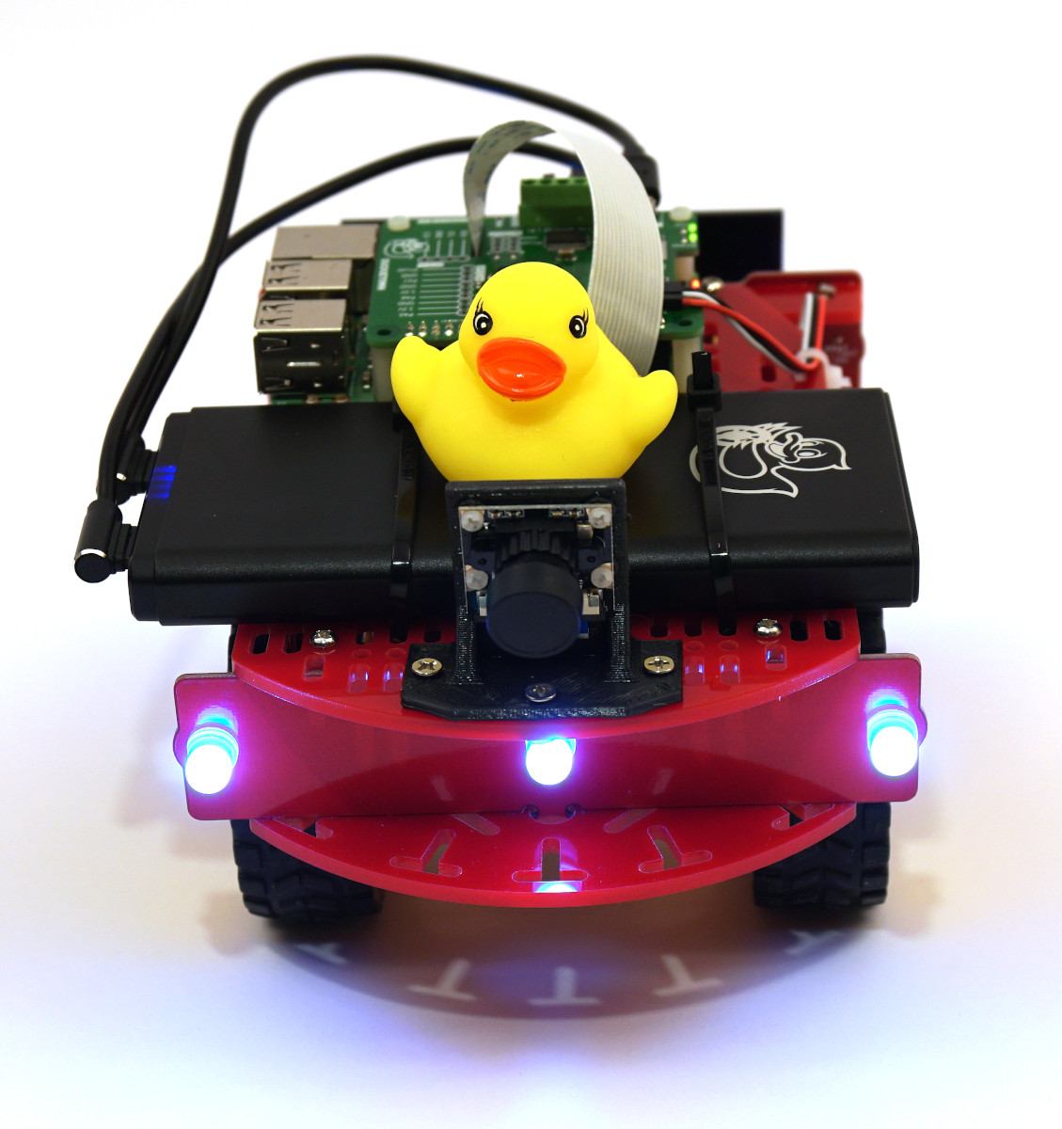
Objective
Approach
Develop dynamic obstacle avoidance for Duckiebots in Duckietown
Implement distance detection for the closest obstacle, executing a backward maneuver if the obstacle is dangerously close (>20cm).
Notes:
The primary objective of this project is to develop a dynamic obstacle avoidance feature that enables a Duckiebot to safely navigate through a simple Duckietown environment by effectively passing slow or stationary Duckiebots.
In order to achieve this objective, several intermediate objectives are defined as follows:
Detecting the distance from the obstacle that is closest to the Duckiebot
If the obstacle is dangerously close (>20cm) make the duckiebot back down until it is at a safe distance away.
To streamline the scope of the project, certain assumptions have been made:
Only straight lanes without turns are considered.
Obstacle Duckiebots are assumed not to weave across lanes, ensuring their confinement within their respective lanes.

Slide 4
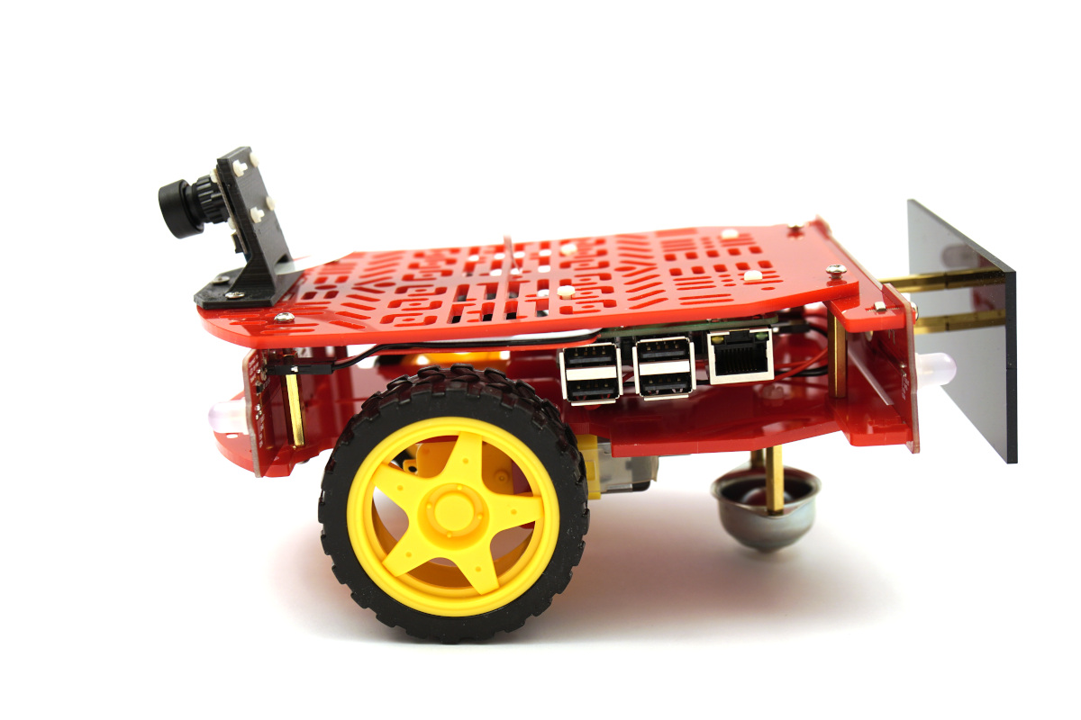
Preliminaries
Duckie bot with calibrated camera and wheels
Familiarity with the Time of Flight (TOF) sensor
Store and access data on DBS and docker containers
Notes:
To successfully implement our project, several key preliminaries are required:
Familiarity with the Time of Flight (TOF) sensor for obstacle detection.
Understanding of the Duckietown pipeline, particularly its lane-following functionality.
A fully functional Duckiebot with calibrated camera and wheels.
These prerequisites provide the necessary foundation for accurate obstacle detection, integration into the Duckietown ecosystem, and autonomous navigation with obstacle avoidance capabilities.

Slide 5
Obstacle Detection Techniques

Slide 6
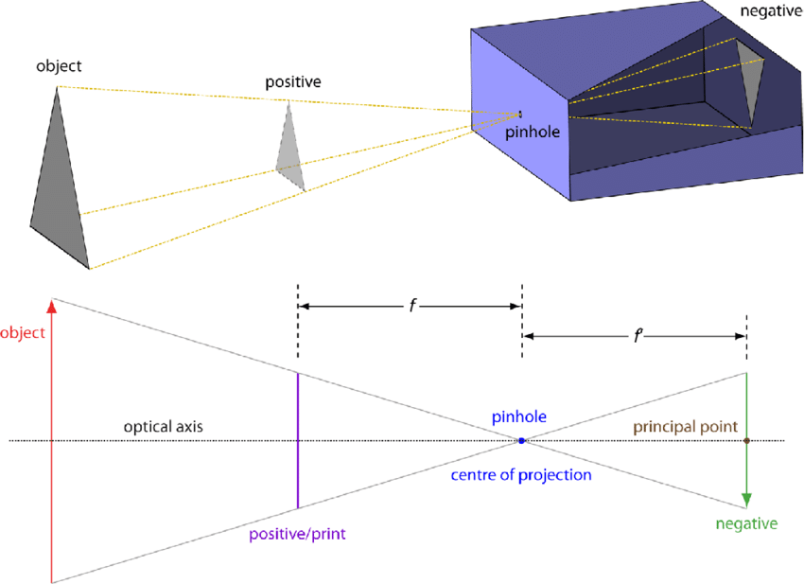
PinHole Camera Model
LED detection based on OpenCV functions for blob detection and the pinhole camera model to estimate the positions of the detected Duckiebots.

Slide 7
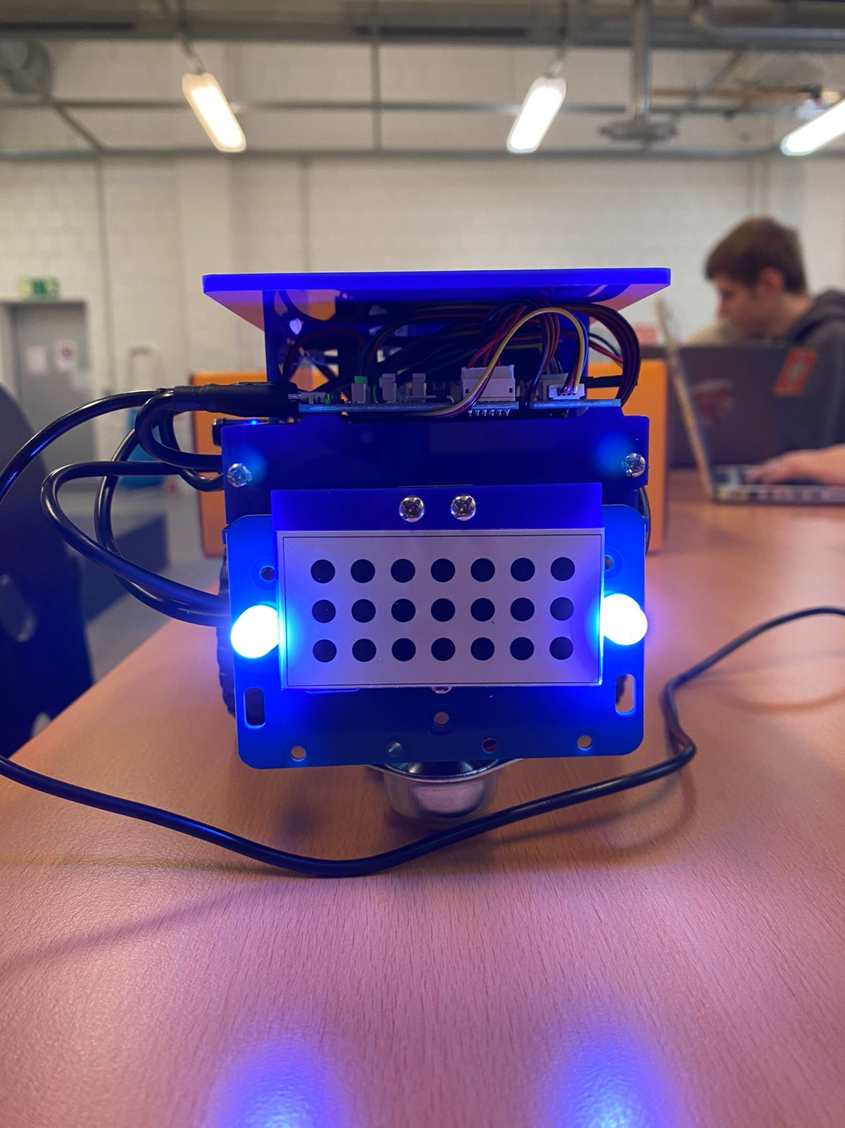
PinHole Camera Model

Slide 8
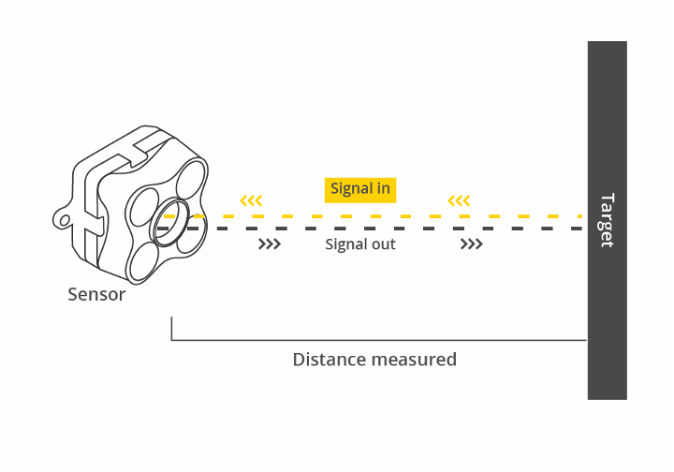
Time of Flight (TOF)
Detect obstacles by measuring the distance from an object to the sensor
Notes:
Using a Time of Flight (TOF) sensor for dynamic obstacle avoidance offers advantages over a pinhole camera model. TOF sensors provide real-time distance measurement, ensuring precise and responsive obstacle detection. They are simpler, more robust, and less affected by calibration and environmental factors. TOF sensors inherently provide depth perception, eliminating the need for additional depth estimation algorithms. They excel at close-range detection, making them effective in congested environments. Overall, TOF sensors offer superior performance and suitability for dynamic obstacle avoidance compared to a pinhole camera model.

Slide 9
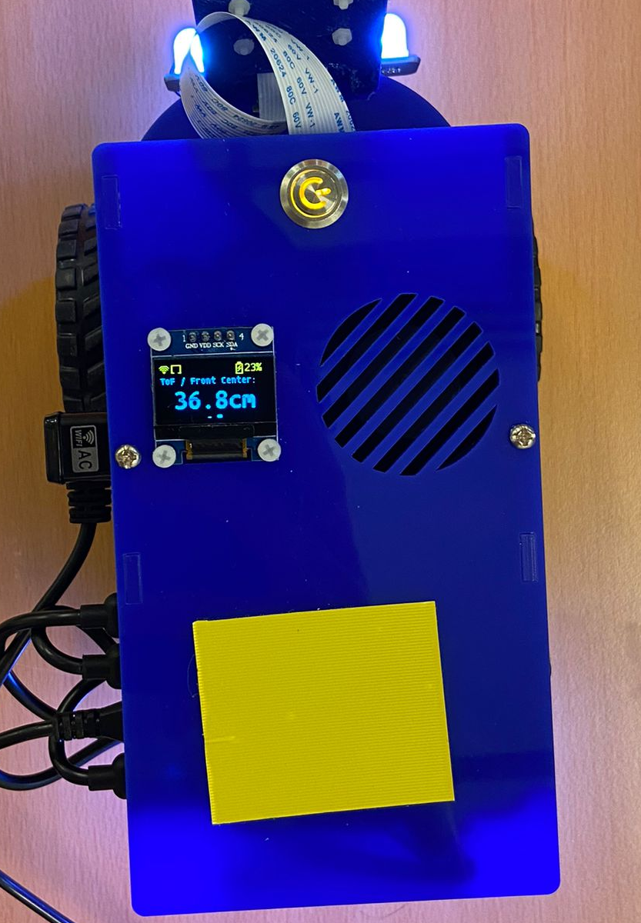
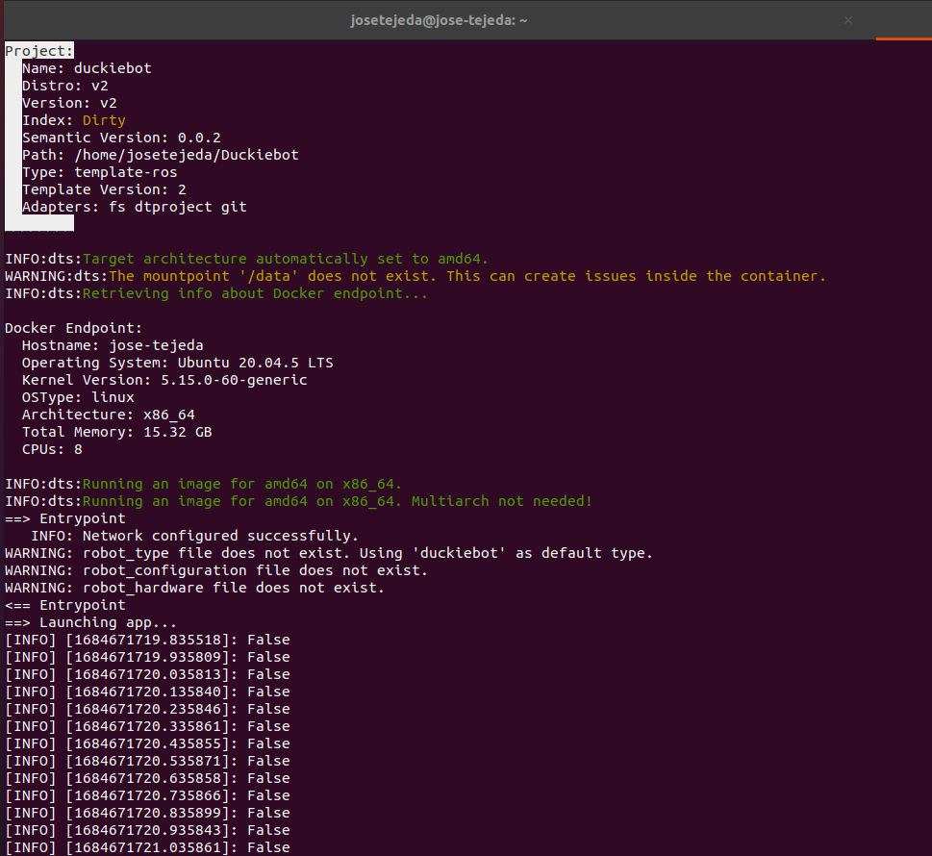
Time of Flight
Distance Measured by TOF Sensor

Slide 10
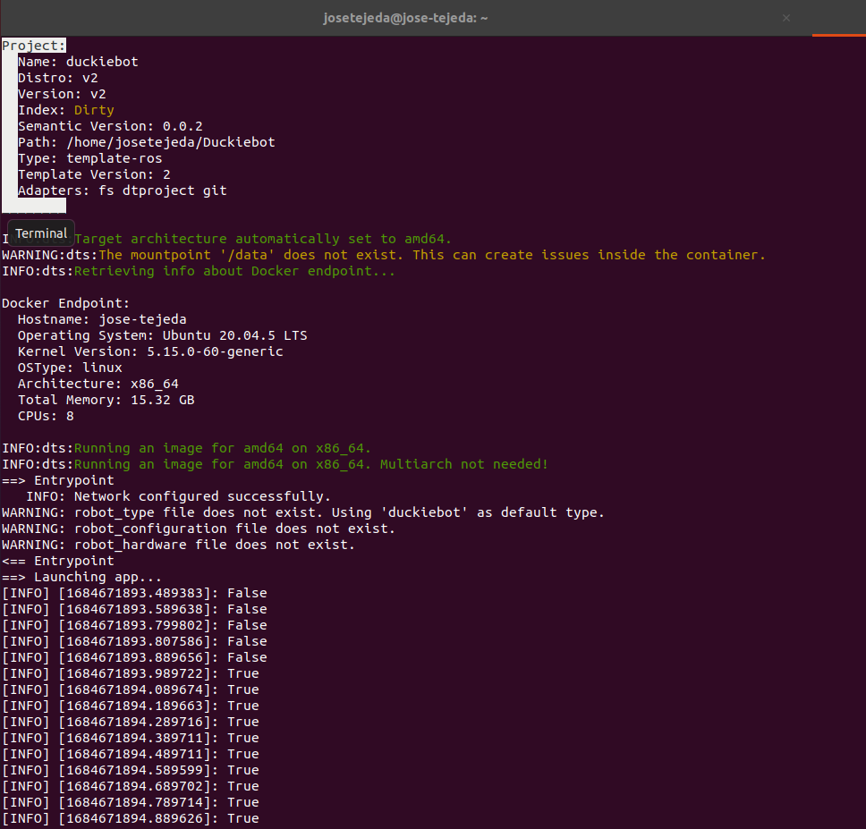
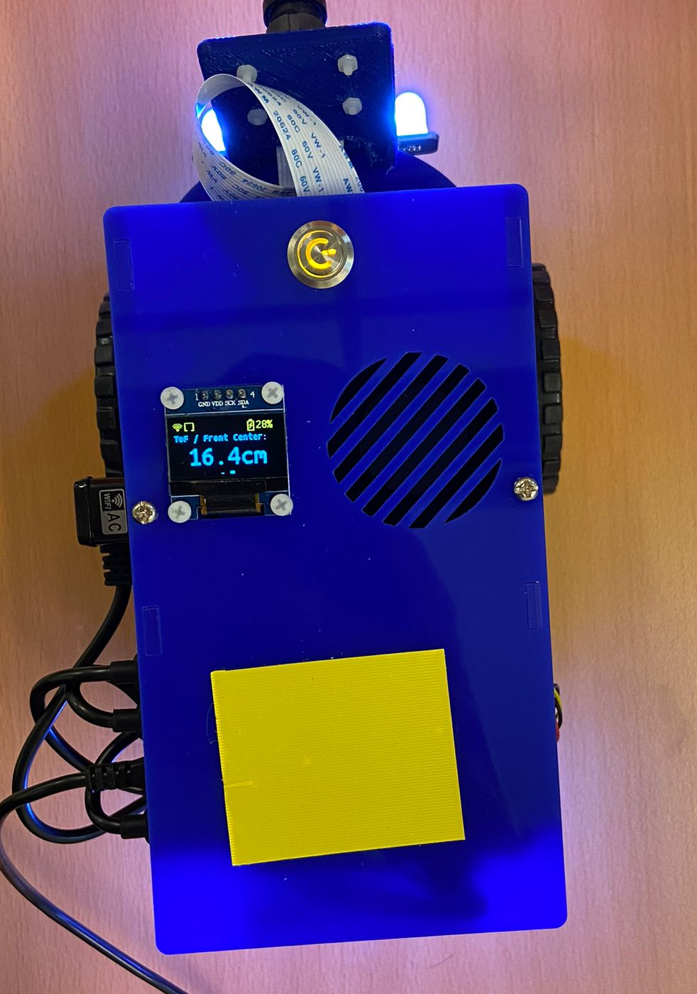
Time of Flight
Distance Measured by TOF Sensor

Slide 11
Decision Logic

Slide 12
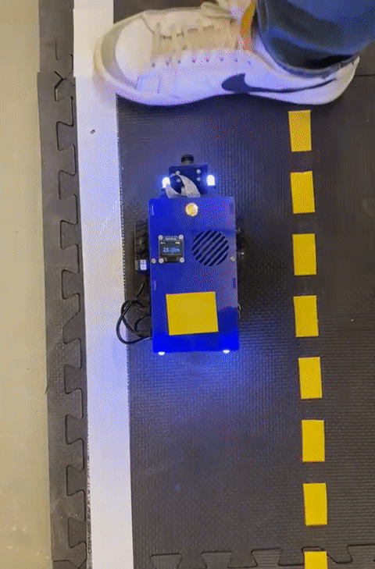
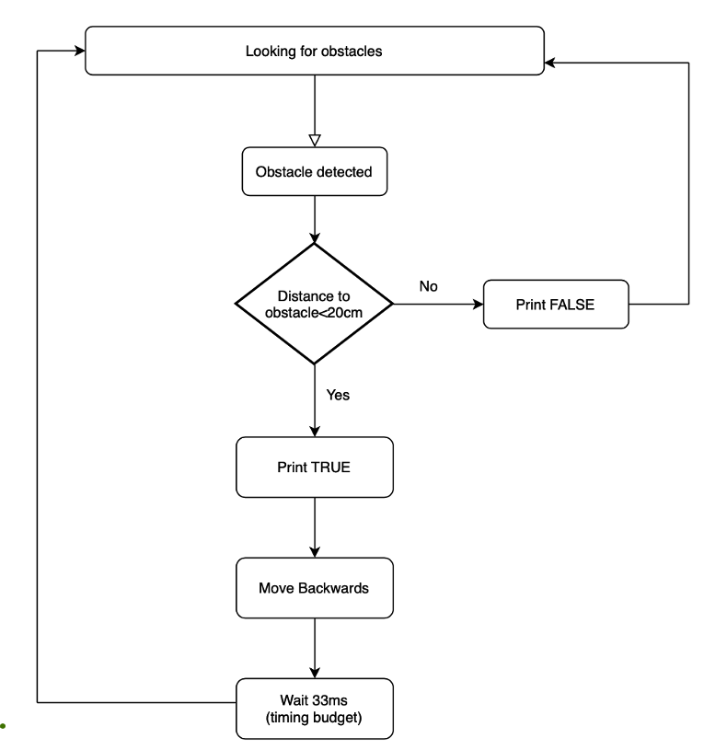
Decision logic

Slide 13
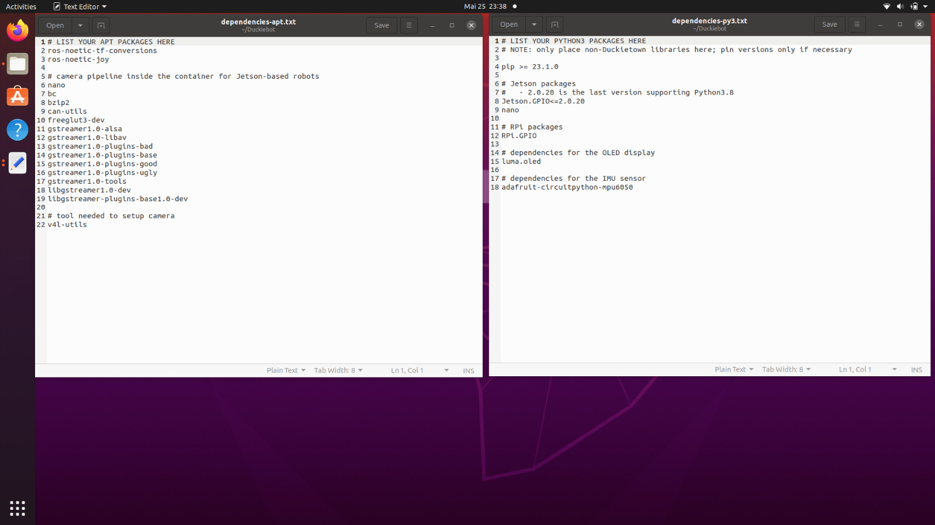
Dependencies

Slide 14
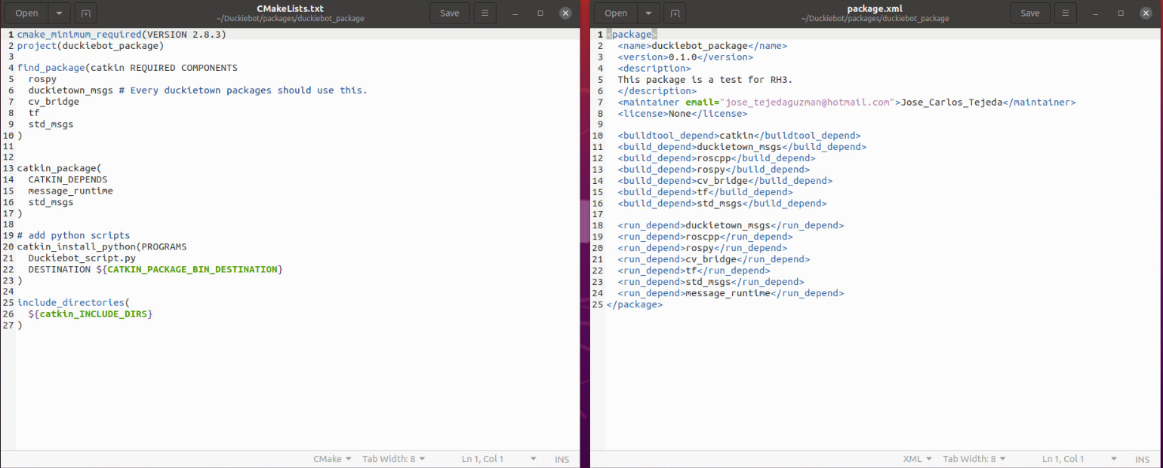
CMakeLists and xml

Slide 15
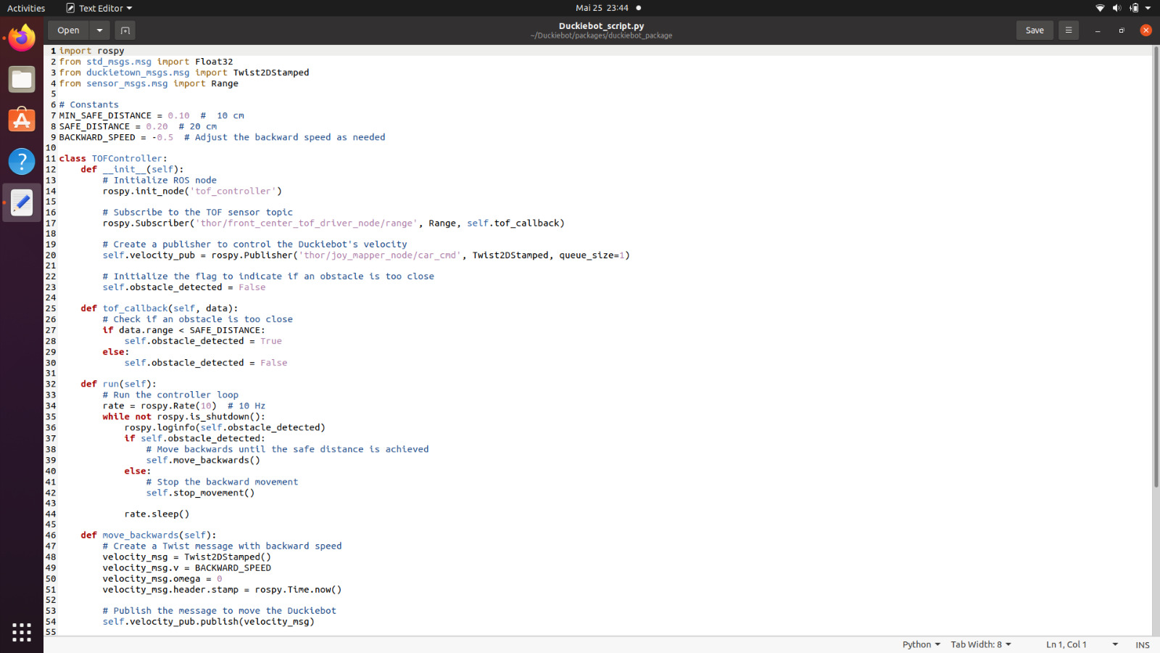
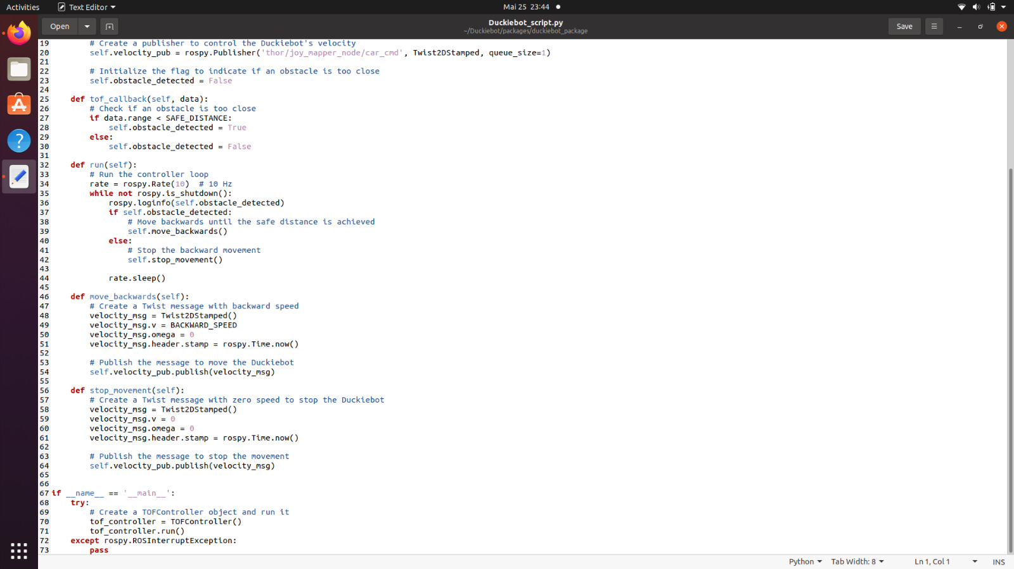
Duckiebot_script.py

Slide 16
Results

Slide 17
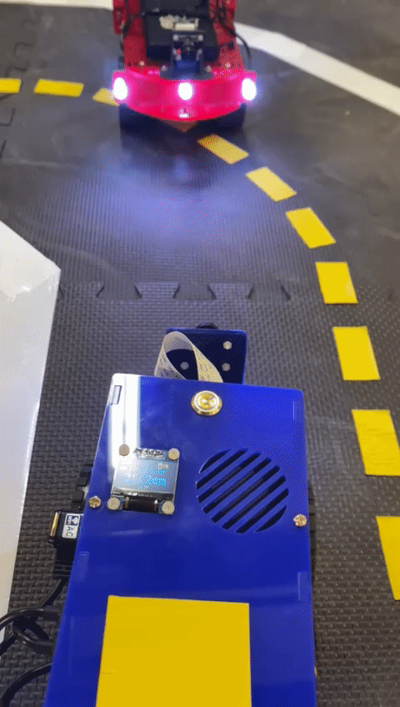
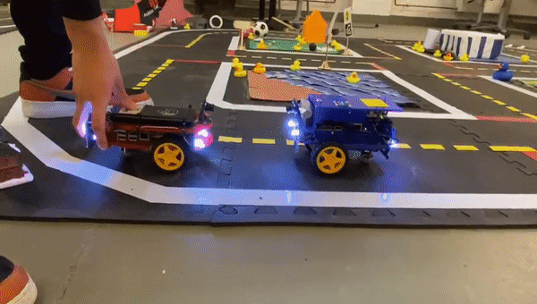

Results
Notes:
The results of our project were highly successful, as demonstrated in the videos showcasing the Duckiebot's ability to detect objects and effectively avoid collisions by executing backward maneuvers. This accomplishment represents a significant advancement in achieving a robust 2-dimensional dynamic obstacle avoidance system.
During the practical application of the project, we observed that the actual performance of the TOF sensor did not precisely align with the specifications mentioned in the datasheet. Various factors, such as lighting conditions and the colour of the surface of the detected object, influenced the effective range of the sensor. As a result, the usable range that consistently provided reliable detection and avoidance capabilities for our project was found to be between 10cm and 100cm.
This deviation from the stated range in the datasheet highlights the importance of real-world testing and adaptation in the development process. By actively assessing the sensor's behaviour under different environmental conditions, we were able to determine a practical range that ensured accurate obstacle detection and avoidance in our specific application.
Despite these variations, the Duckiebot performed admirably and successfully navigated through its environment, effectively responding to potential hazards and avoiding collisions within the established operational range of the TOF sensor. This achievement reinforces the effectiveness of our approach and the capability of the Duckiebot to autonomously navigate in a dynamic and obstacle-rich environment.

Slide 18
Challenges

Slide 19
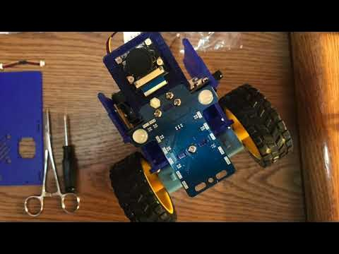
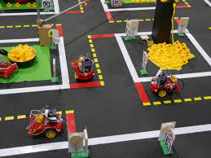
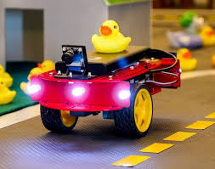
Challenges
Time constraints and hardware issues
Autonomy and obstacle detection
Satisfactory goal achievement
Notes:
• Time constraints and hardware issues
One major hurdle we faced was the limited timeframe for the project, which put pressure on the development process. Additionally, we encountered frequent hardware errors with the Duckiebots, necessitating multiple iterations and replacements. These unexpected setbacks caused delays and affected the overall progress of the project.
• Autonomy and obstacle detection
Achieving autonomous navigation and obstacle detection in a 2-dimensional environment presented its own set of challenges. Designing a robust system that could reliably detect not only other Duckiebots but any obstacles required extensive testing, tuning, and refining of algorithms
• Satisfactory goal achievement
While we strived to meet our objectives, ensuring a satisfactory outcome was another challenge. Balancing the capabilities of the Duckiebot to achieve reliable obstacle detection and avoidance while considering the time limitations and hardware issues posed a considerable challenge.

Slide 20
Future Ideas!

Slide 21
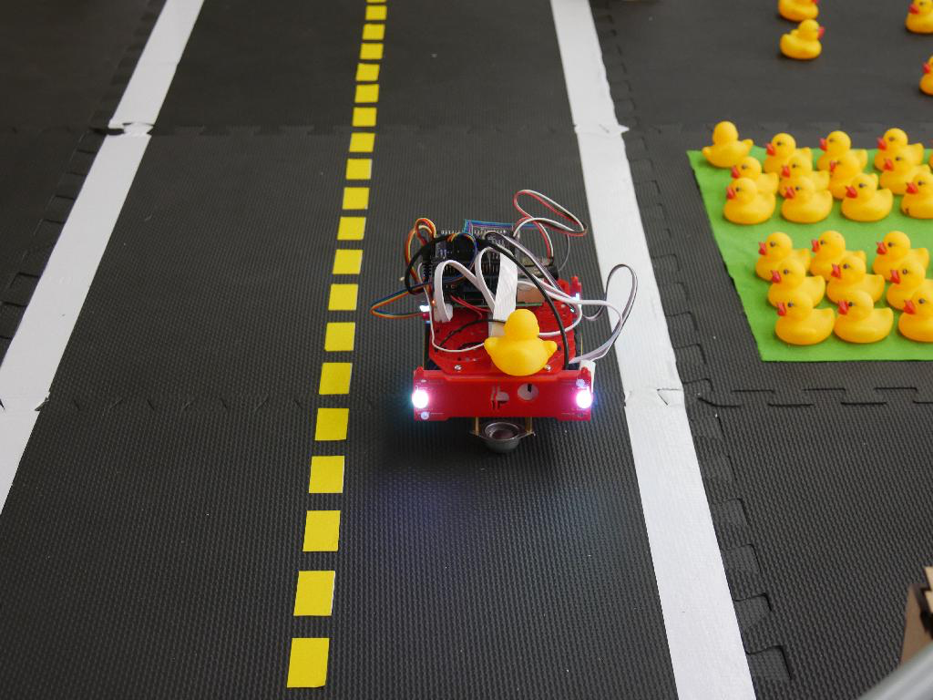
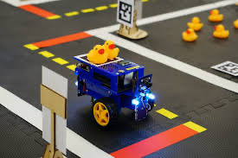
Future ideas
Lane following
Side obstacle detection
Dynamic lane switching
Notes:
• Lane Following: Enhance Duckiebot's autonomous navigation by integrating lane following capabilities, ensuring it stays within designated lanes and maintains a consistent trajectory.
• Dynamic Lane Switching: Allowing Duckiebot to adapt to changing road conditions by autonomously analyzing congestion or obstacles and making informed decisions to switch to safer or less congested lanes.
• Side Obstacle Detection: Improving Duckiebot's situational awareness by detecting obstacles approaching from the sides, using additional sensors or advanced computer vision techniques for comprehensive obstacle avoidance.

Slide 22


